Slide 1
Review 4
Lesson 7: Good and bad driving habits
Lesson 8: Car problems

Slide 2
What did you learn last week? What will we learn today?

Slide 3
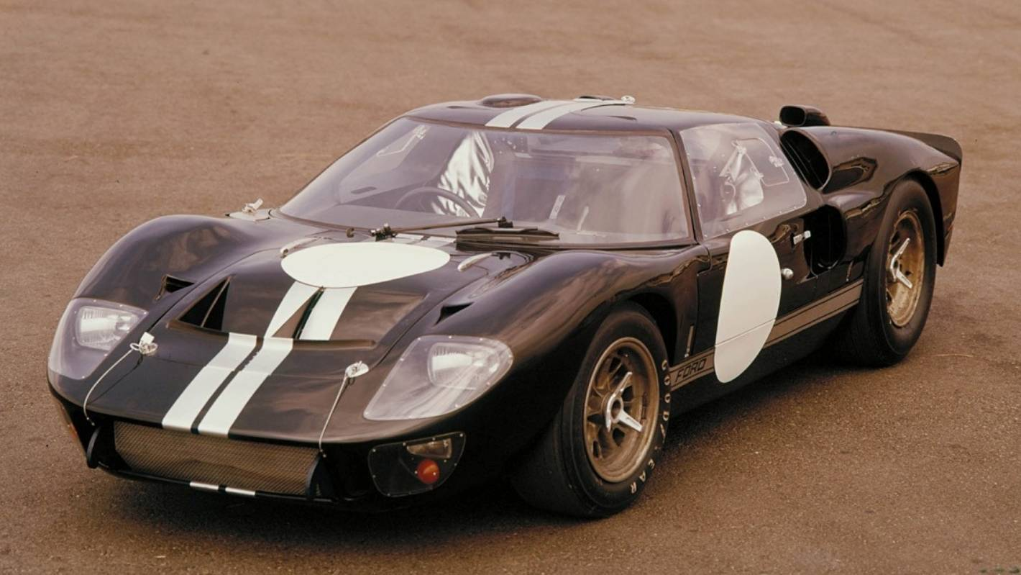
Objectives
Vocabulary
Discuss good and bad driving habits
Describe an accident
Grammar
Past continuous
Speaking topic
Talk about good and bad driving habits

Slide 4
Vocabulary
Good and bad driving habits

Slide 5
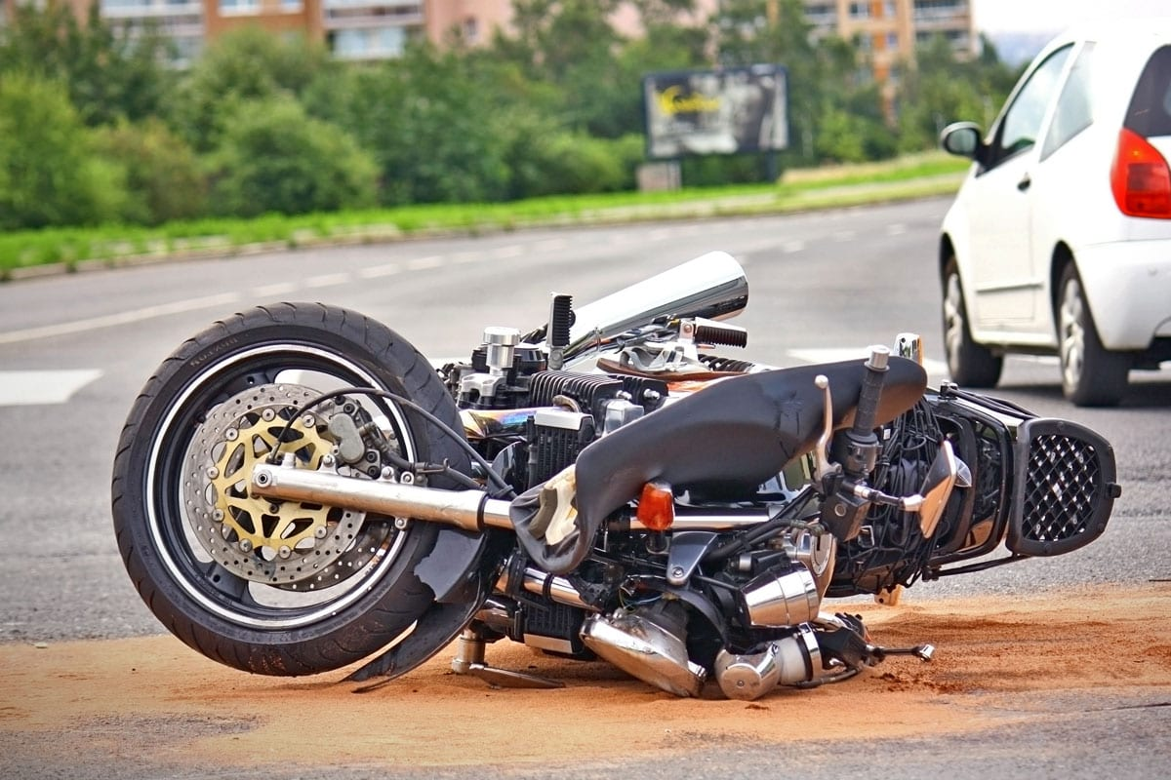
What can you do to ride safely?
What can cause an accident?
What happened?
Notes:
10 minutes
Teacher shows each question and elitcits the vocabulary in unit 7 (good and bad driving habits)
Students work in pairs / teams to discuss and answer each question.
Students can write down the answers on white boards / jamboard / paper...
Q2 + Q3: Examples of good and bad driving habits

Slide 6
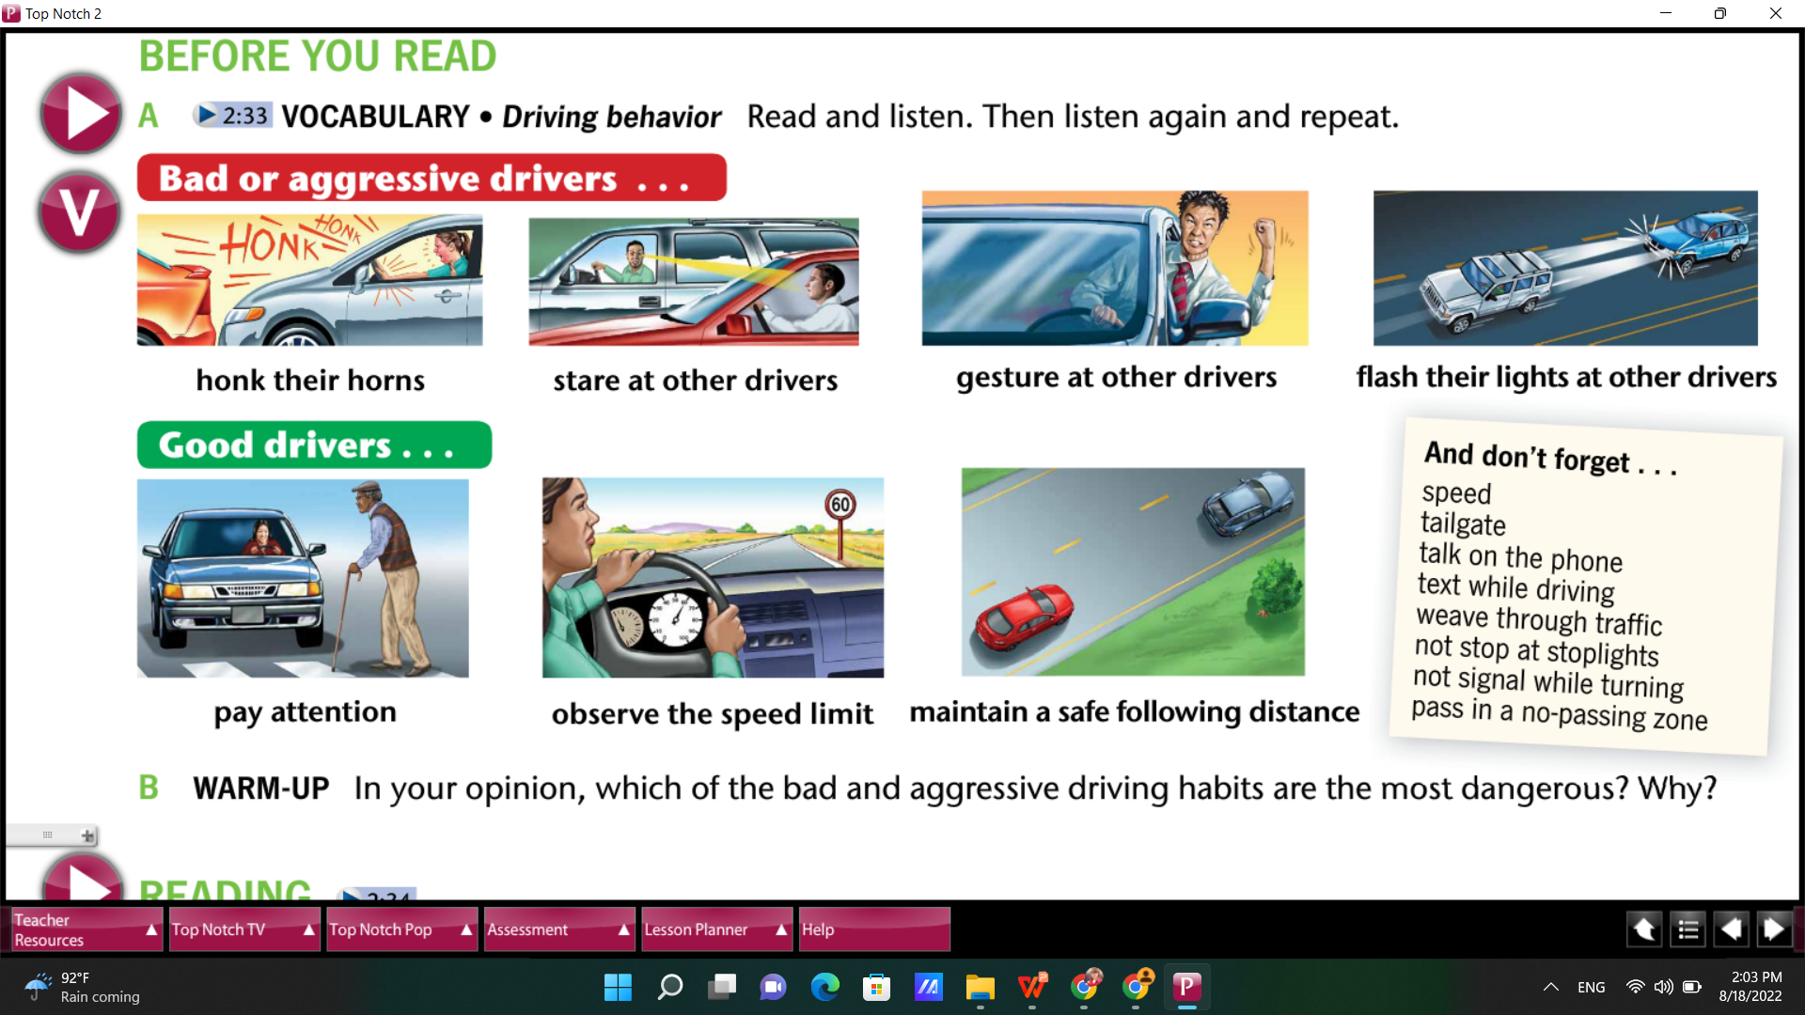
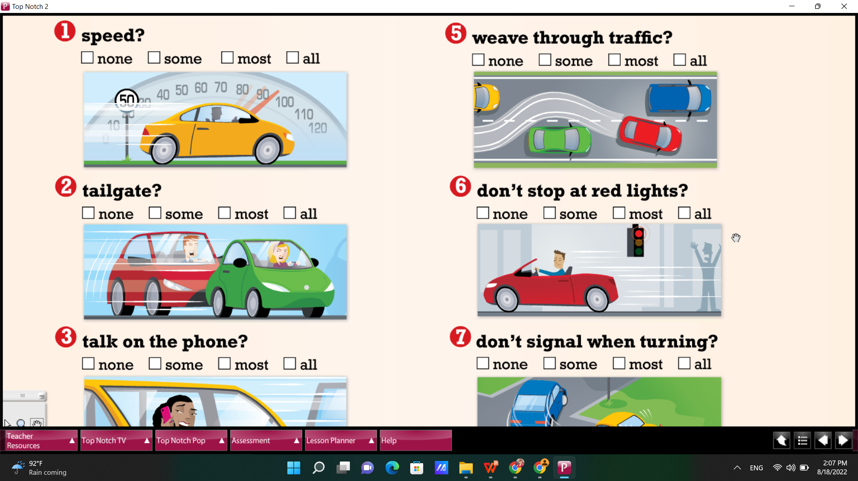
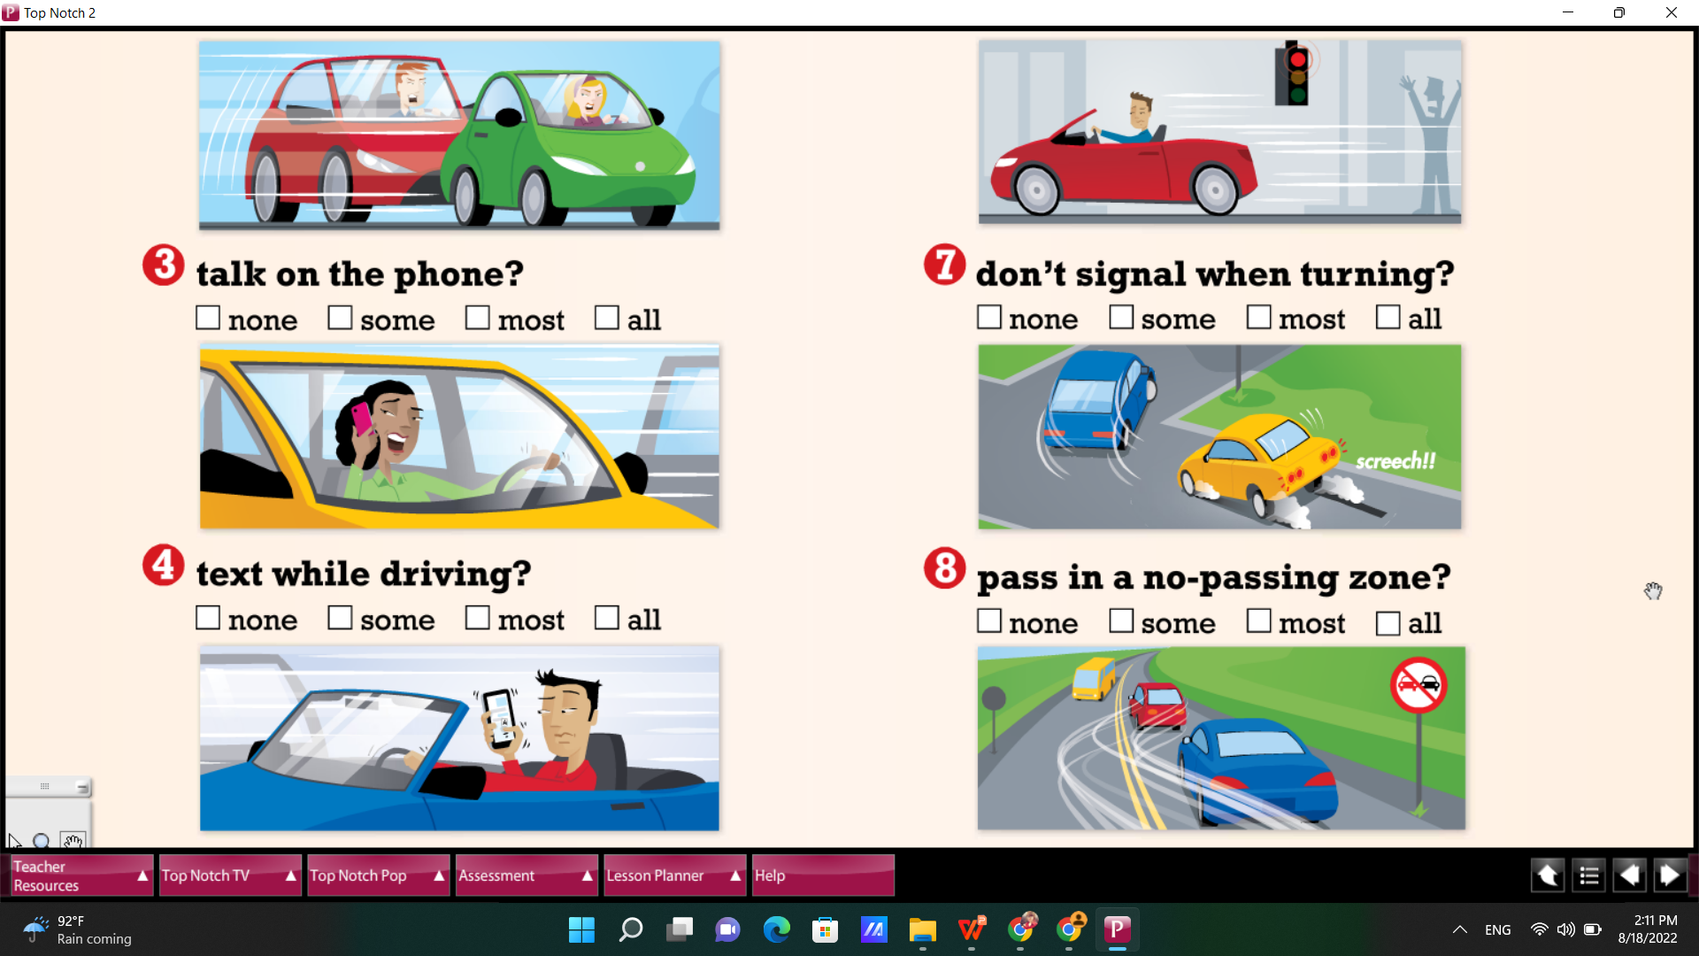
Good and bad driving habits
?
?
?
?
1
2
3
4
flash their lights at other drivers
maintain a safe following distance
observe the speed limit
stare at other drivers
gesture at other drivers
honk their horns
pay attention
?
?
?
?
5
6
7
Notes:
15 minutes
Picture 1: Teacher reviews vocabulary by showing the picture and asking students to name the habits, teacher uncovers each habit after students give answers. Then teacher can make some questions: Do you ... (speed? tailgate?...)
Picture 2: Match pictures to habits

Slide 7
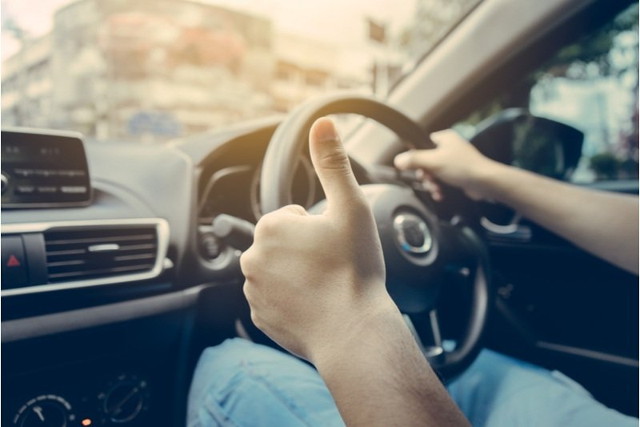
Group work: Which ones are good and bad driving habits? (5 - 7 mins)
Good driving habits (good drivers) | Bad driving habits (bad drivers)
Pay attention | Speed
... | ...
Notes:
Students work in groups to sort out good and bad driving habits, teacher explains ‘good driving habits’ = ‘good drivers’
Students don’t have to make full sentences, just list out the actions

Slide 8

Pronunciation: Good and bad driving habits
Notes:
10 minutes
Picture 1: Teacher reviews vocabulary by showing the picture and asking students to name the habits, teacher uncovers each habit after students give answers. Then teacher can make some questions: Do you ... (speed? tailgate?...)
Picture 2: Match pictures to habits

Slide 9
Speed
Look and guess what habit it is
Honk (their) horns
Pay attention
Observe the speed limit
Talk on the phone
Maintain a safe following distance
Tailgate
Not stop at red lights
Not signal when turning
Flash their lights at other drivers
Pass in a no-passing zone
Notes:
Pictionary: students look at the picture and guess the driving habits
Time limit: <5 minutes

Slide 10

Work in pairs to review the vocabulary
Good drivers often...
Bad drivers often...
Bad drivers often...
Good drivers often...
Notes:
students take turns to share their ideas about good and bad drivers
time limit: <5 minutes

Slide 11
Work in pairs: What is the most dangerous driving behavior?
Notes:
Teacher asks students to discuss in pairs and choose one behavior
For stronger classes, students can explain it’s the most dangerous behavior (because it scares people riding on the road that can cause an accident...)
time limit: 5 minutes
teacher invites one student from each team to present his/her group’s opinion

Slide 12
Speaking
Driving habits

Slide 13
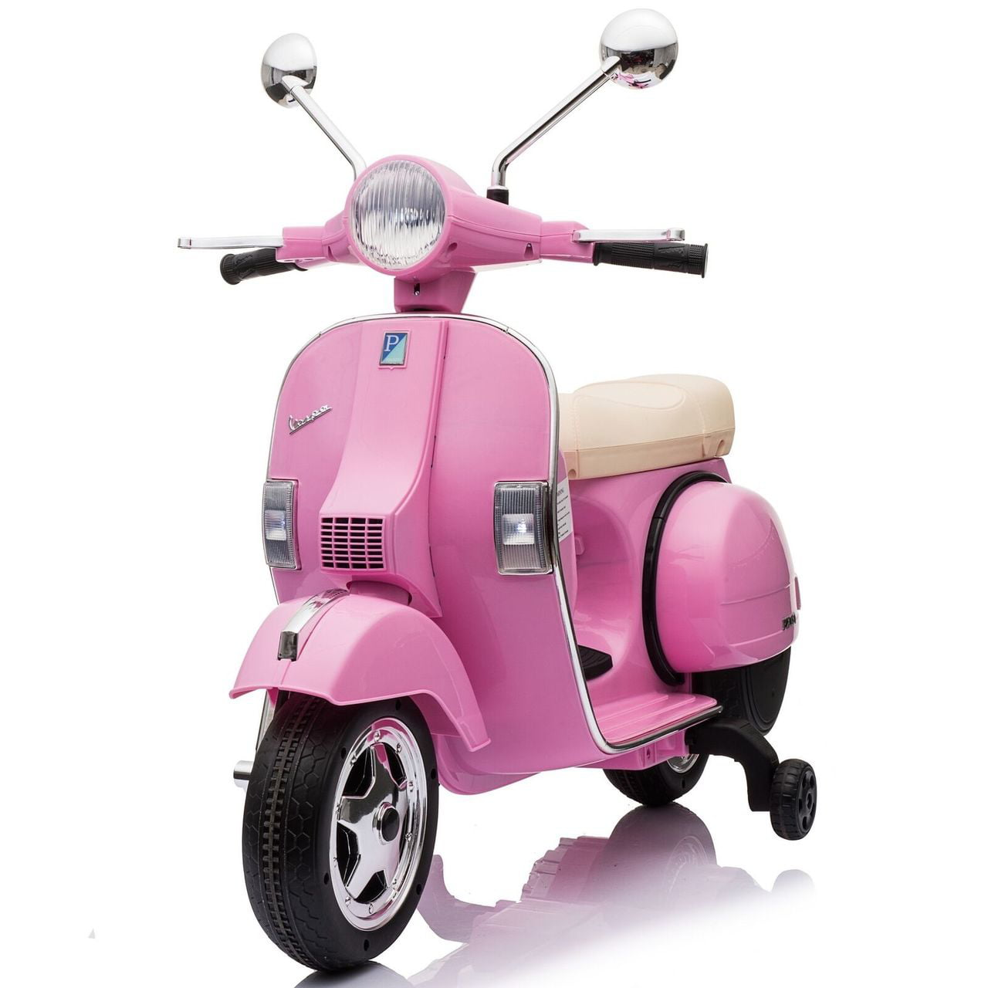
1. Can you ride a motorbike?
Yes, I can.
2. How long have you ridden motorbike?
I’ve ridden motorbike for 3 years.
I’ve ridden motorbike since I was 18 years old.
3. Do you have a motorbike at home?
Yes, I do.
4. Are you a good motorbike rider/motorbiker? Why?
I think I’m a good motorbiker because I always pay attention.
Notes:
15 minutes
Question 4: Students can link to “Which driving habits do you usually have?”to explain, they’re good or bad motorbikers because they usually ... (pay attention...)

Slide 14
Vocabulary
Types of cars
Parts of cars

Slide 15
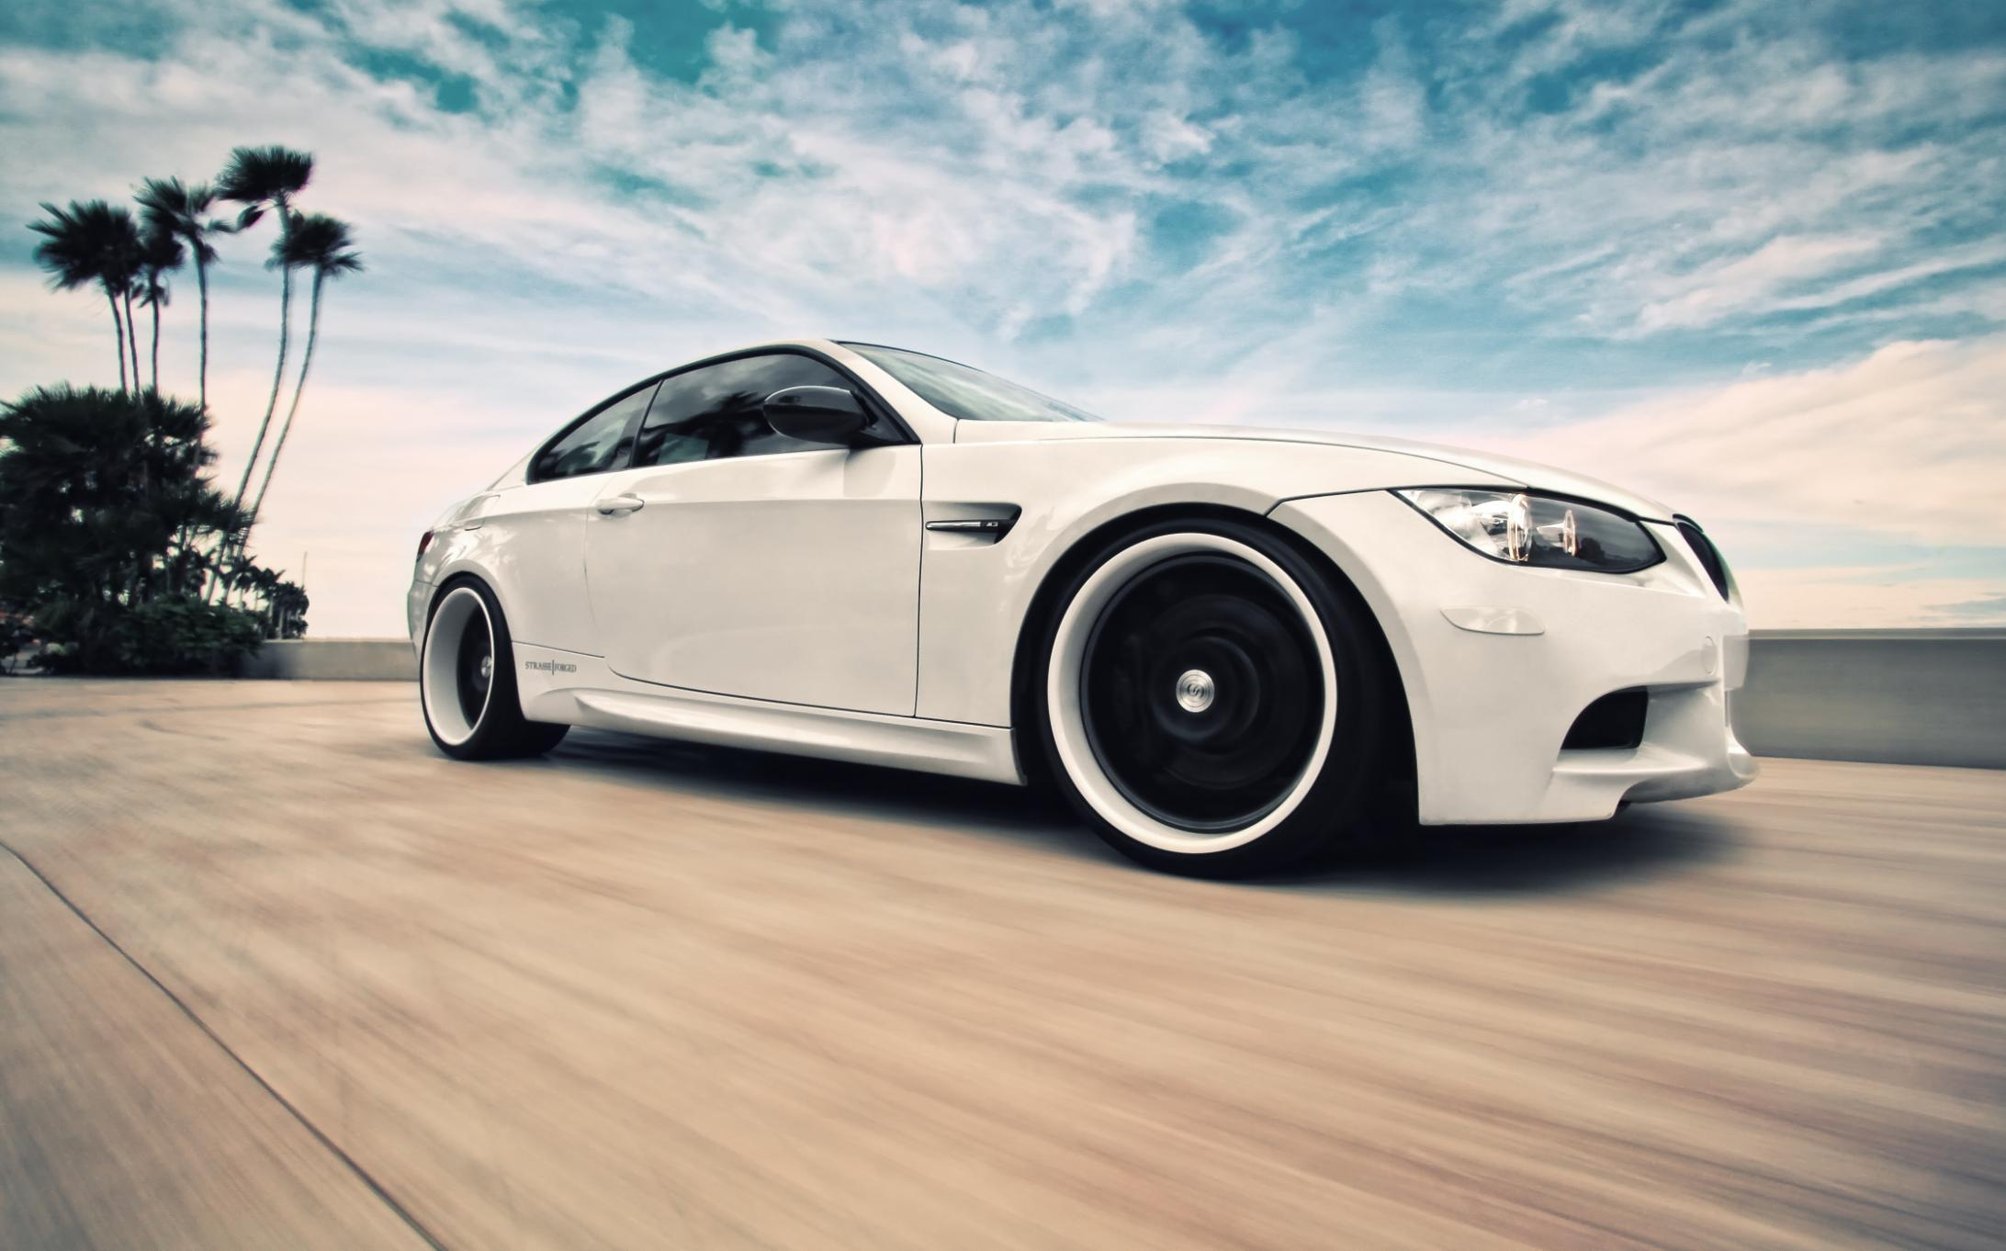
Name some types of cars in 1 minute
01:00

Slide 16
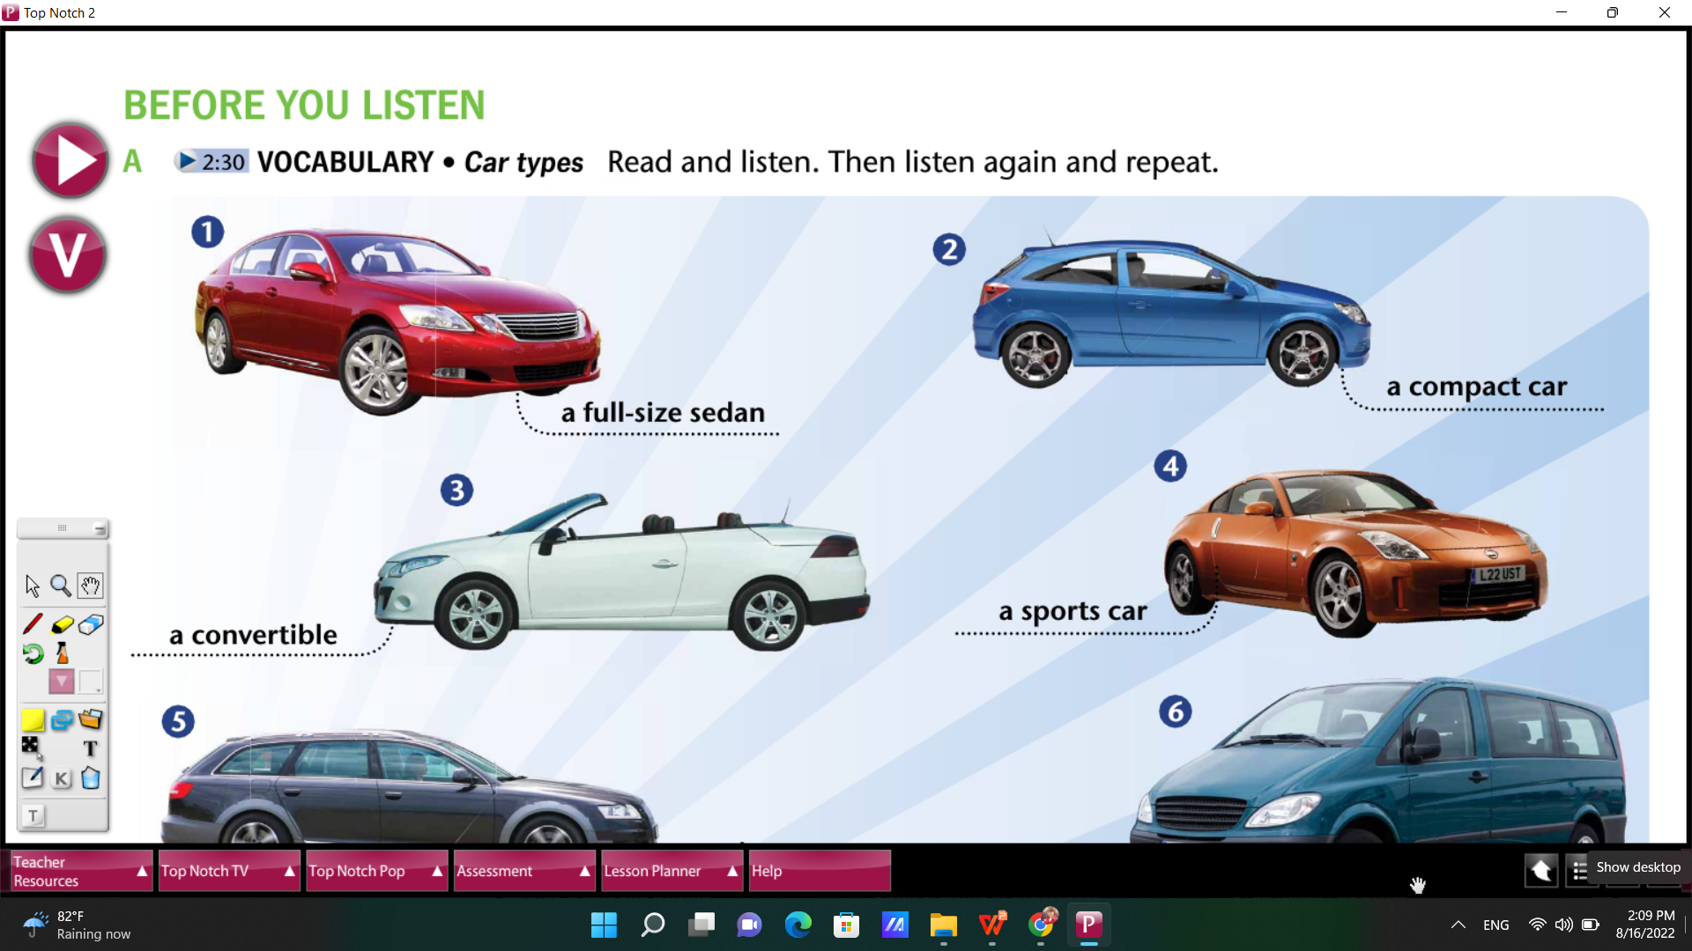
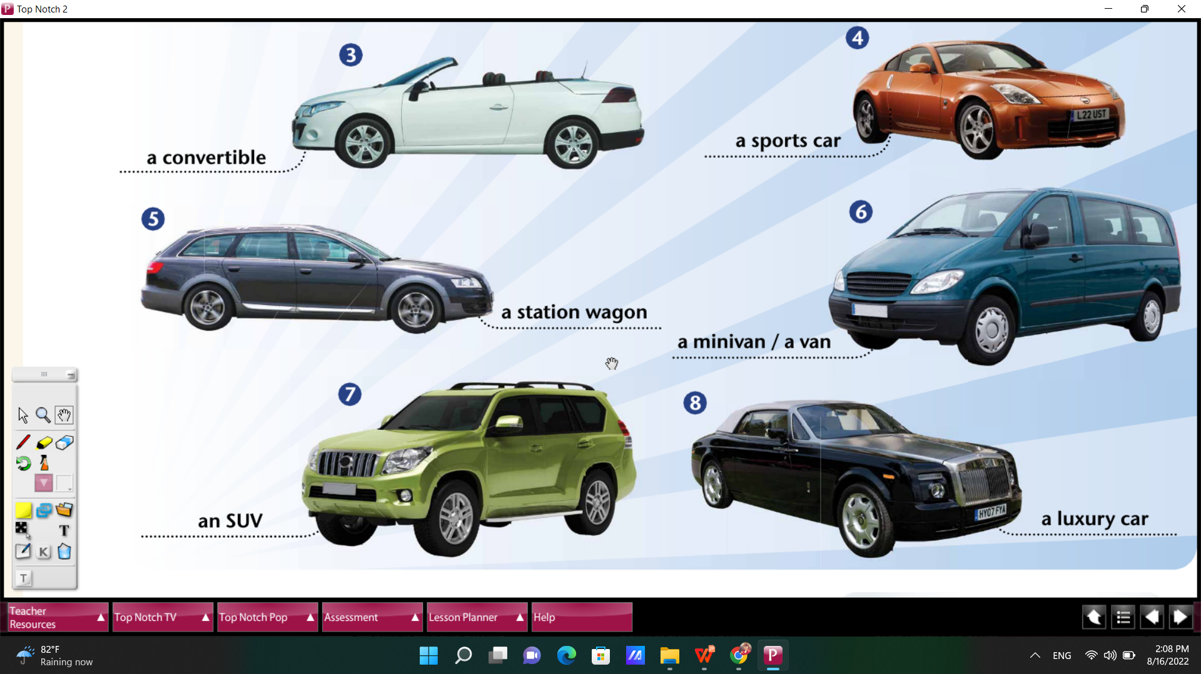
Notes:
7 minutes
Listen and repeat: Pronunciation double check

Slide 17
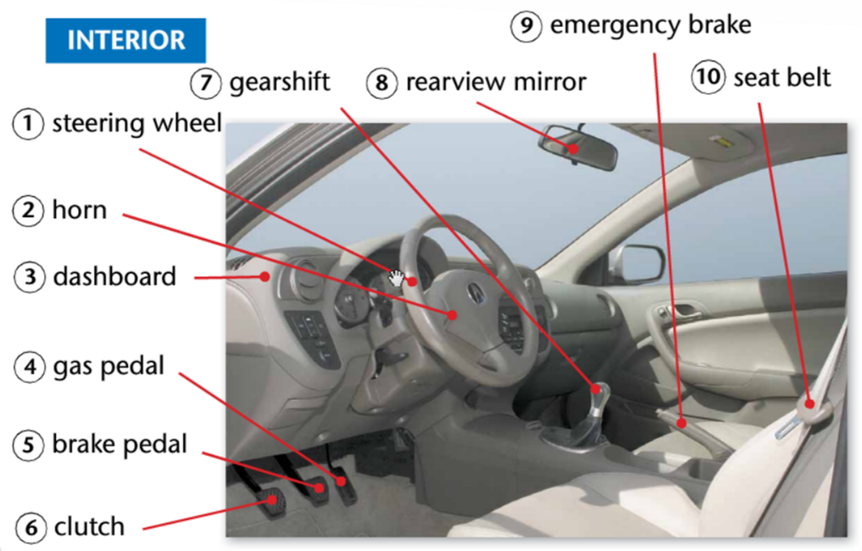

01:00
Parts of Cars
Write the missing words?
Notes:
Only focus on INTERIOR
Order: number9 →number2 →number5 →number8 →number10

Slide 18
Translation: - Look at the picture - Match the vietnamese words to the english words

Slide 19
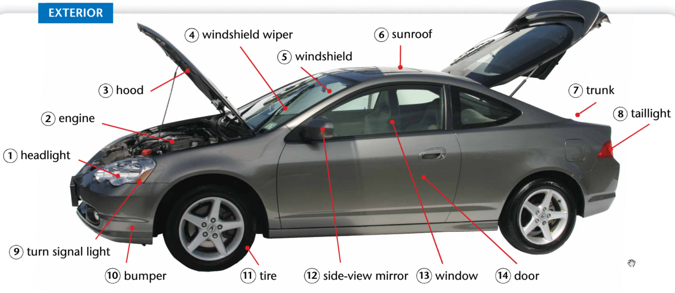
cốp xe
lốp xe
bộ phận giảm sốc
kính chiếu hậu
kính chắn gió
cần gạt nước
đèn đuôi xe
động cơ
cửa sổ
Notes:
time limit: 5 minutes
Focus on EXTERIOR
Pronunciation check

Slide 20
Grammar
What were you doing at 10pm last night?
Past Continuous
Notes:
Teacher asks students the question and supports/corrects students’ answers
Teacher asks students what tense they’re using to answer the question

Slide 21
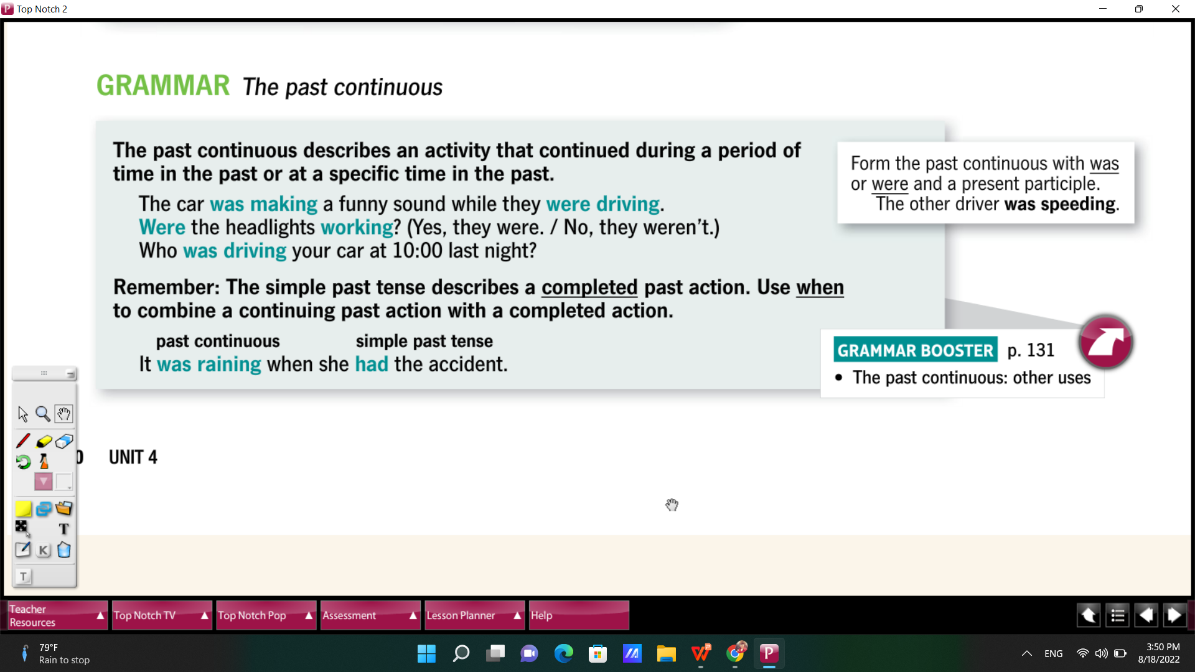
Notes:
Check when students use ‘was’and ‘were’, after tobe, what form of verb do they use?
teacher can also double check Verb-ing rules (students already learned Present Continuous)
Time limit: 3 minutes

Slide 22
Team work: in 5 minutes...
How do you form a sentence in Past Continuous?
Affirmative (+) | Negative (-) | Yes/No questions (?) | Wh- questions (?)
Notes:
Teacher assigns each group 1 structure
Students write general structures (S+was/were+Ving)

Slide 23
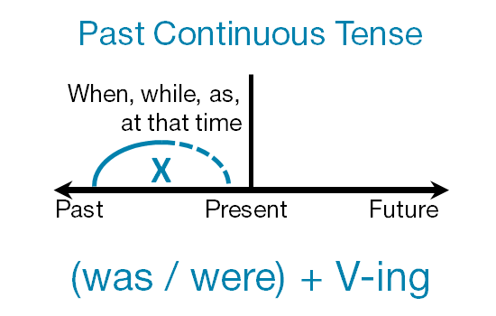
Practice: Choose the correct actions in Past Continuous?
Notes:
Teacher asks students:
1. When do you use Past Continuous?
2. Make a sentence in Past Continuous
3. Remind students of Past Simple, compare Past Continuous and Past Simple
Time limit: 5 minutes

Slide 24
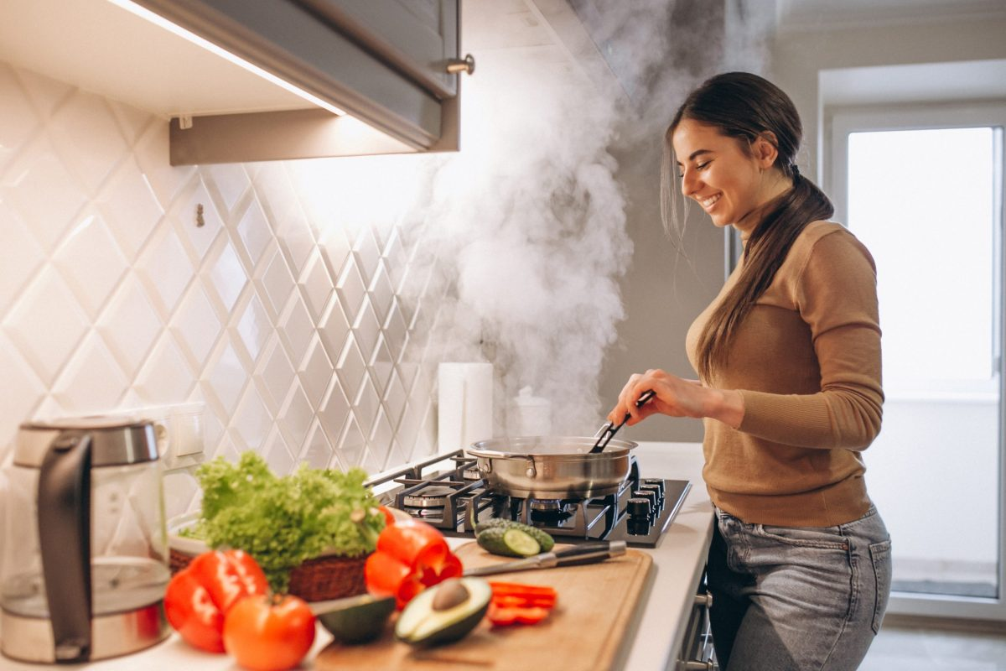
Last night, I visited my friend.
When I arrived, ...
A. she was cooking
B. she was watching TV
C. she was sleeping
Notes:
The purpose of this practice is to help students remember to use Past Simple after When and Past Continuous after the comma
For strong classes, teacher teaches students While + past continuous, past simple

Slide 25

Last night, I visited my friend.
When I arrived, ...
A. she was playing games
B. she was studying
C. she was watching TV

Slide 26

Last night, I visited my friend.
When I arrived, ...
A. she was talking on the phone
B. she was studying
C. she was checking emails

Slide 27

Last night, I visited my friend.
When I arrived, ...
A. she was sleeping
B. she was listening to music
C. she was drawing

Slide 28
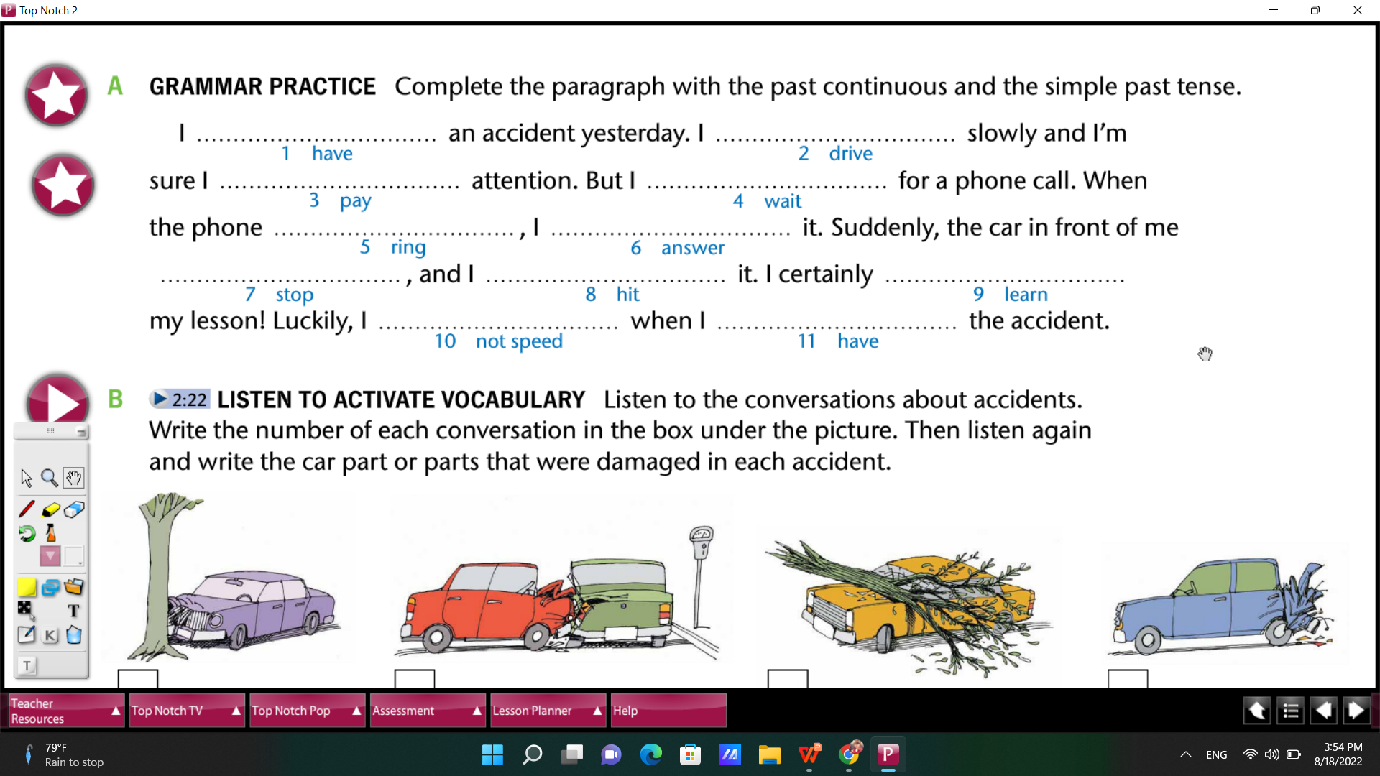
Practice: Fill in the gaps?
had
was driving
was paying
was waiting
rang
answered
stopped
hit
learnt/learned
didn’t speed
had
Notes:
7 minutes
The purpose is help students review Ved and Ving

Slide 29
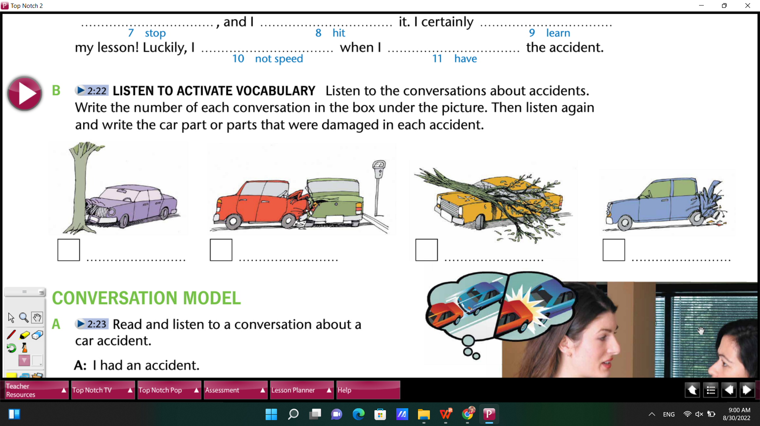
Listening Practice
3
brake
2
hood
1
windshield
4
trunk
Notes:
10 minutes
The purpose of this practice is to make a lead-in step for Speaking (an accident)
Before listen: teacher asks students to describe the accidents using vocabulary about types of cars, parts of cars, what happened (past tenses), because of what bad driving habits?... : 3 minutes
Students don’t have to understand every sentence, only listen for key words, listen twice: 4 minutes
Correction: group check, pair check, teacher invites some students to present ideas

Slide 30
Grammar
Did you fill up the tank before you went to school?
Phrasal Verbs

Slide 31
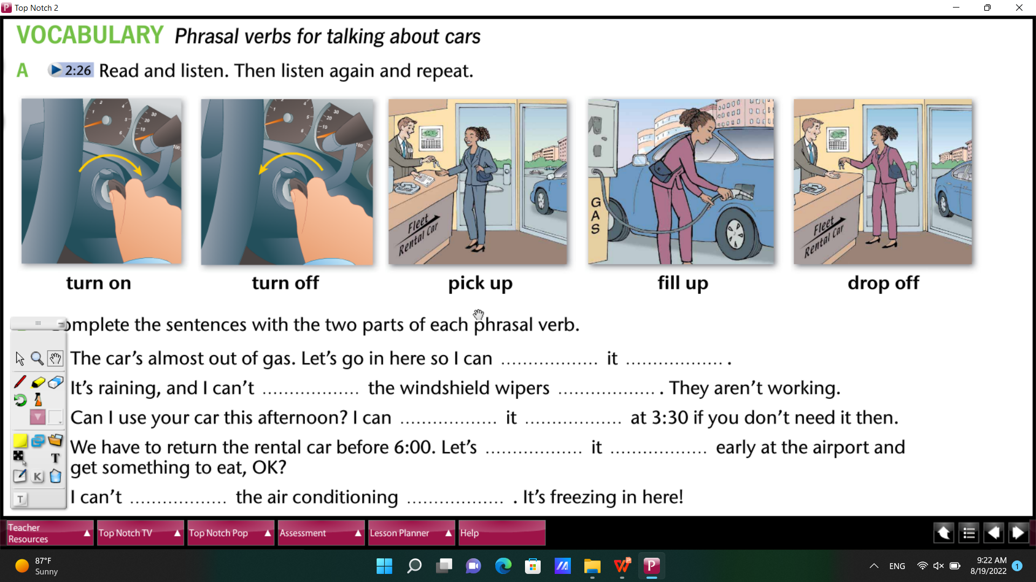
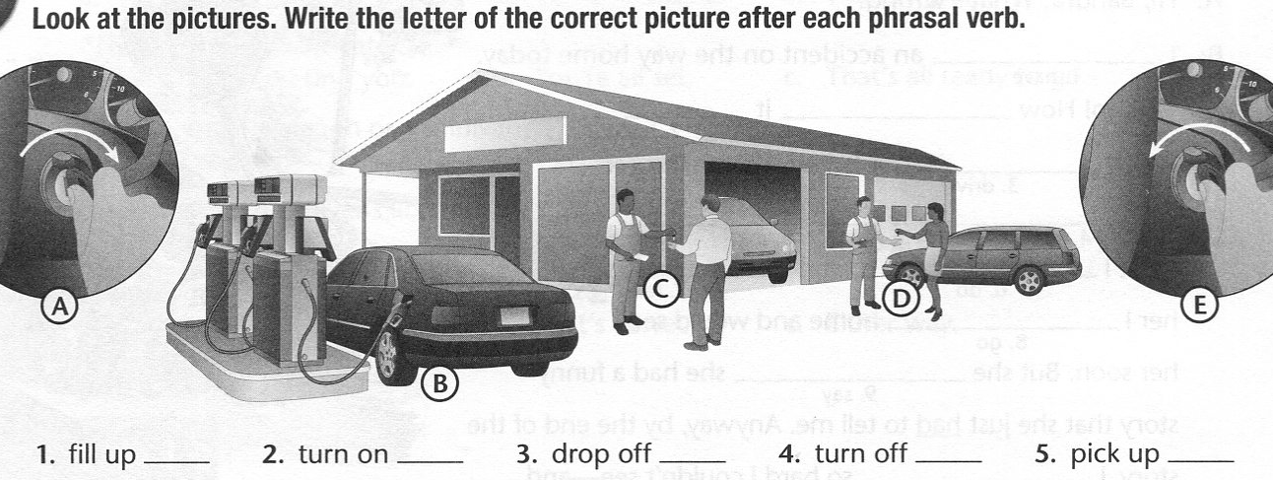
Match the pictures to the verbs?
A
B
C
D
E
D
A
E
B
C
Notes:
time limit: 2 minutes
check pronunciation

Slide 32
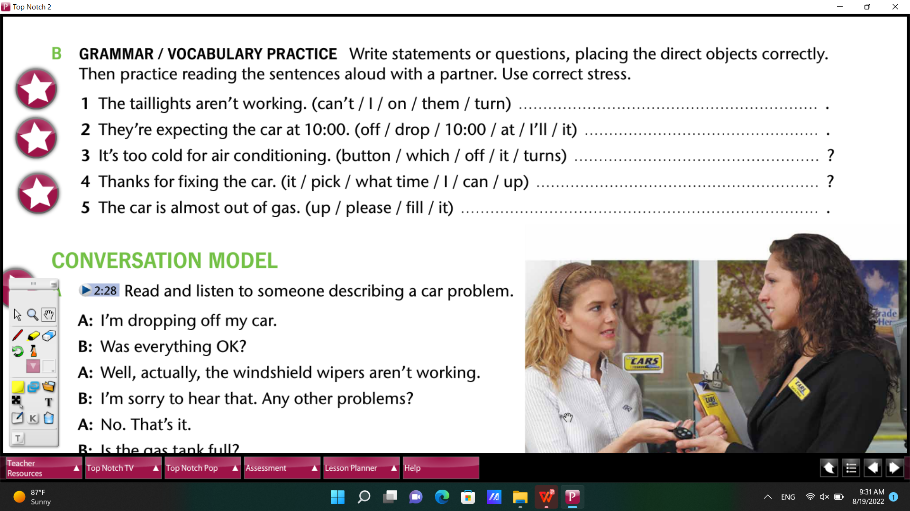
Practice: Unscramble the words
I can’t turn them on
I’ll drop it off at 10:00
which button turns it off
What time can I pick it up
Please fill it up
Notes:
Teacher ask students the position of phrasal verbs in a sentence
Students think about the Verb + Pronoun + Prep

Slide 33
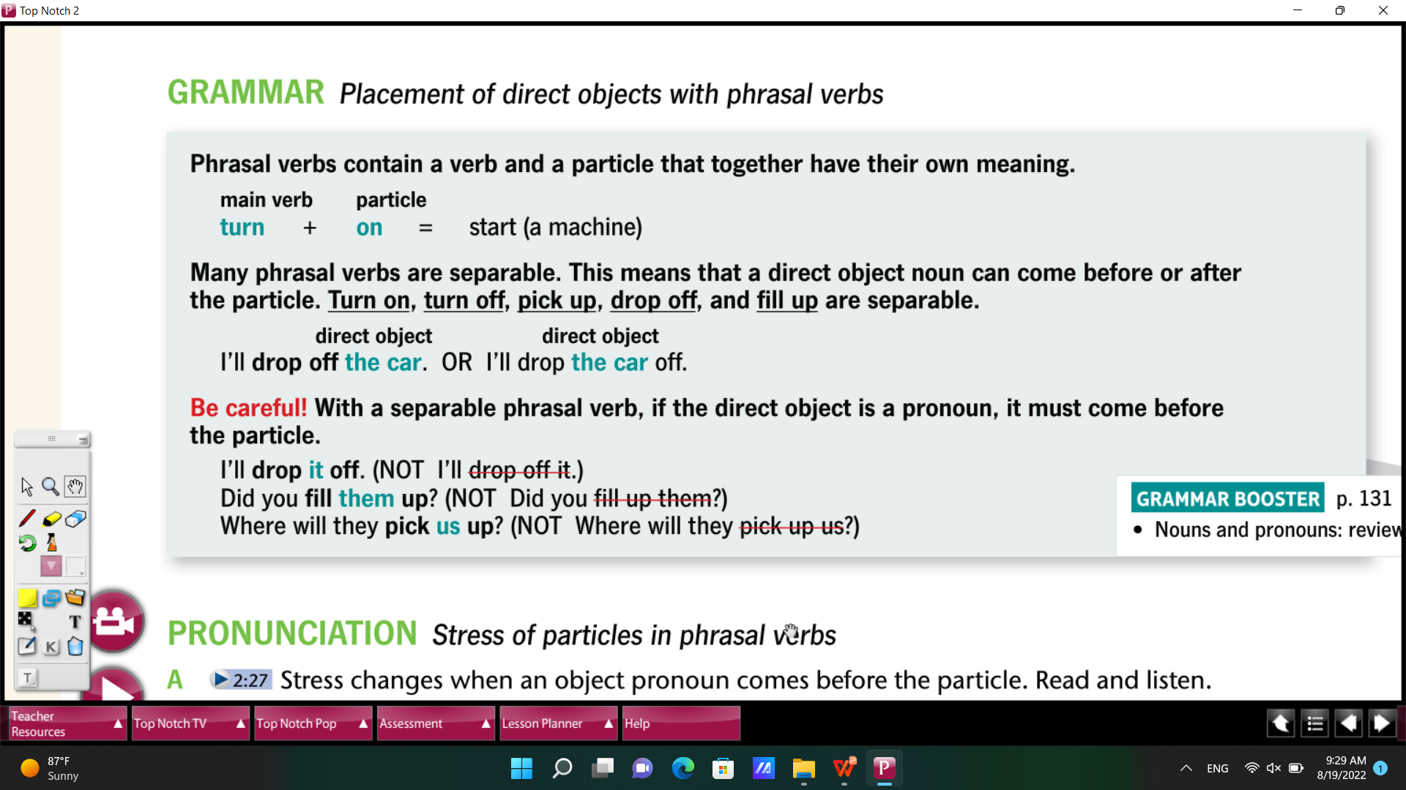

Slide 34
Further Practice
Past Continuous: https://www.liveworksheets.com/worksheets/en/English_as_a_Second_Language_(ESL)/Past_simple_and_past_continuous/Simple_past_-_past_continuous_ex1340933be
Phrasal Verbs:
https://create.kahoot.it/details/8905750a-4e24-430a-a16c-49328d2bc78b
Notes:
Teacher only

Slide 35
Speaking
Describe an accident

Slide 36
When you were coming home, you saw an accident...
Notes:
https://www.youtube.com/watch?v=1s8GAm95XrM&ab_channel=MaddyAnimation

Slide 37


Slide 38
What were you doing when you saw the accident?
Did you help anyone at the accident?
What have you learned after you saw the accident?
Which driving behavior should drivers/riders avoid?
Where was the accident?
When was the accident?
Was anyone hurt?
What happened?
Notes:
Team work: each team write about an accident
Time limit: 12 minutes
Teacher can invite some strong students to share ideas about the questions before they work in teams

Slide 39
Useful structures
An accident
What happened? | Where? When? | Anyone hurt? Damage? | What were you doing? | What have you learned?
- I’ve seen a car accident. - I’ve heard about a bike accident. | - It happened near my house - Two cars crashed into each other - It was 2 weeks ago - I saw / heard about it last week | - Luckily, no one was hurt. - However, some rear mirrors broke. - Unfortunately, a woman broke her leg. - Moreover, the bikes were broken | - I was crossing the road when I saw the accident. (Use Past Continuous) | - I’ve learned to pay attention while riding my bike. - I’ve had a lesson that I must obey the rules while riding. (Use Present Perfect)

Slide 40
Consolidation What have you learned today?
1. Vocabulary
- Good and bad driving habits
- Describe an accident
2. Grammar
- Past Continuous
- Phrasal verbs

Slide 41
Speaking Topic 4
Talk about good and bad driving habits

Slide 42
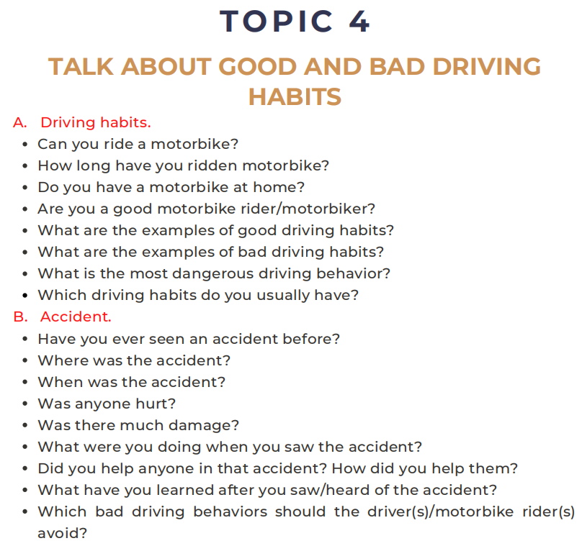

Slide 43
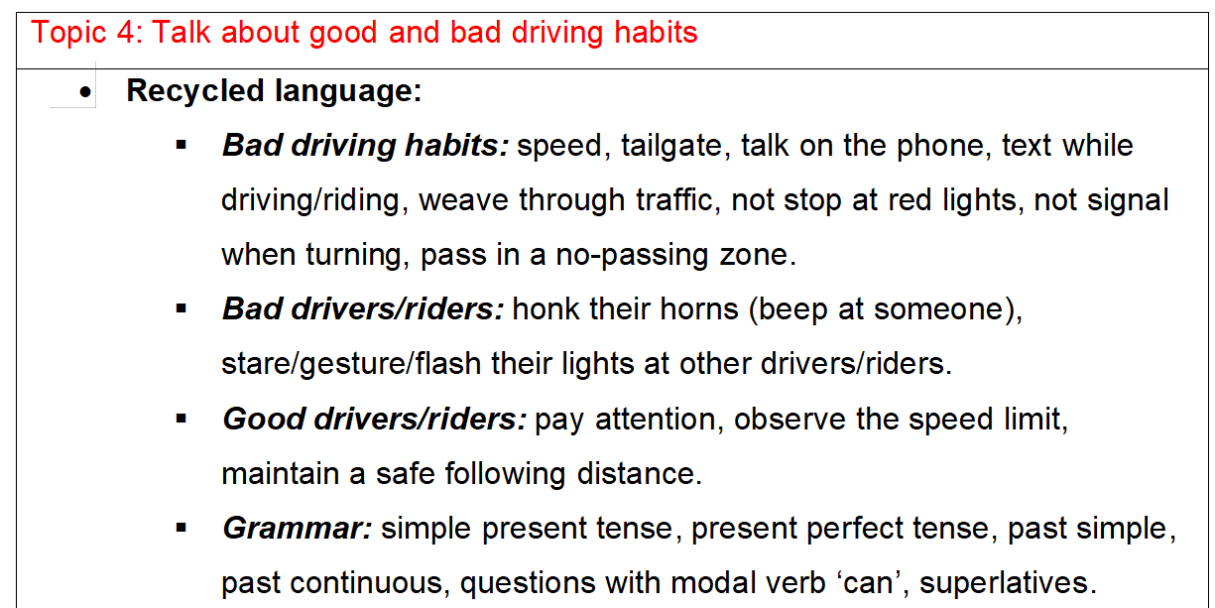
Writing Format

Slide 44
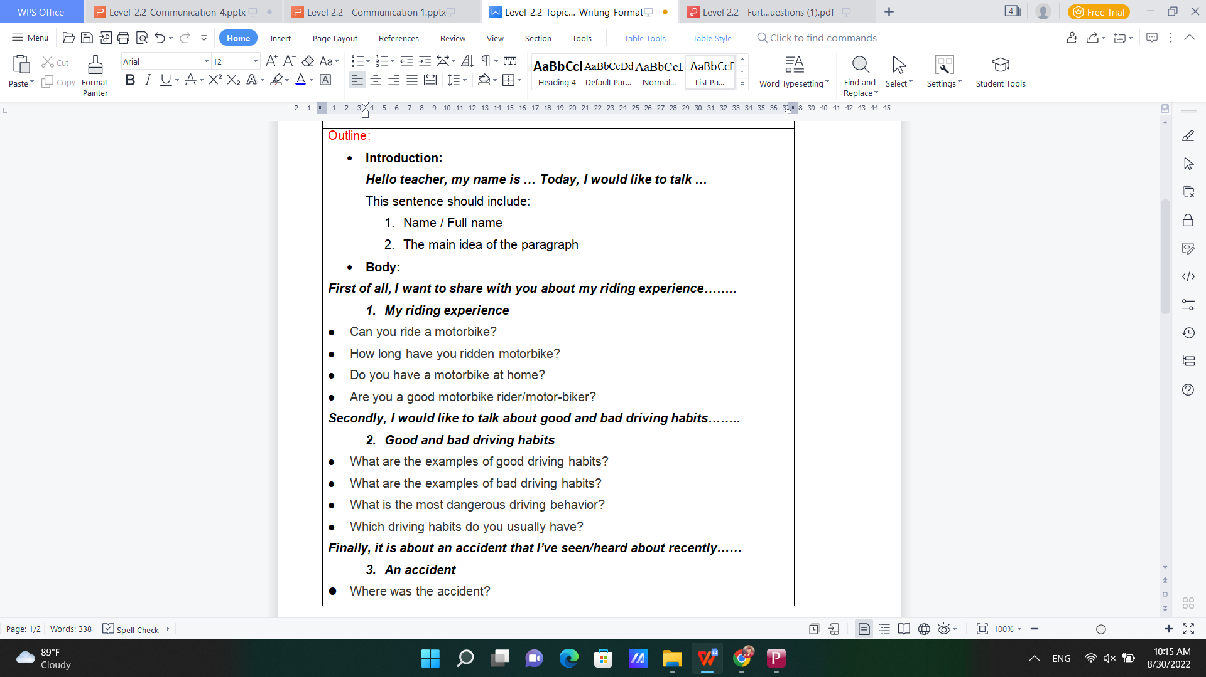
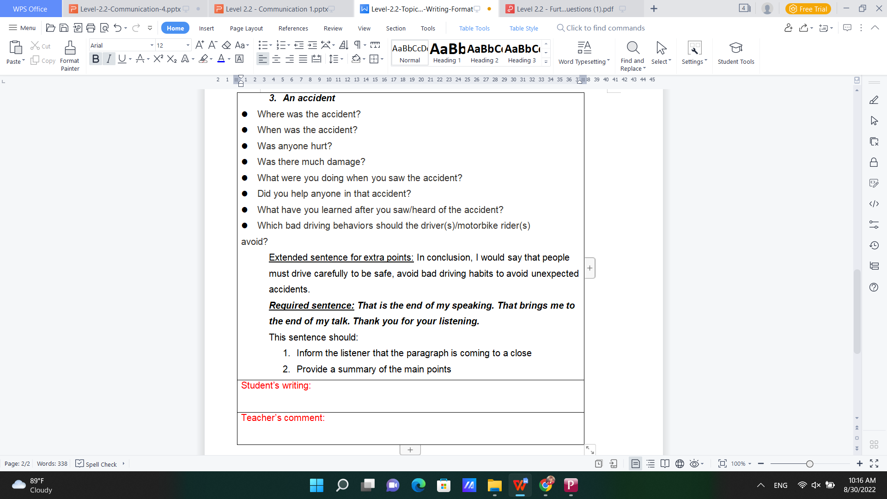

Slide 45
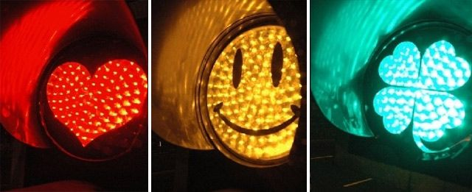
Thank you

